Slide 1
UNIT- III
-
Syllabus
Introducing Classes: Class Fundamentals, Declaring Objects, A Closer Look at new, Assigning Object Reference Variables,
Introducing Methods, Constructors, Parameterized Constructors, The this Keyword, Instance Variable Hiding, Garbage Collection, The finalize Method.
A Closer Look at Methods and Classes: Overloading Methods, Using Objects as Parameters, A Closer Look at Argument Passing, Returning Objects, Introducing Access Control, Understanding static, Introducing final

Slide 2
Classes and Objects
-
Classes and objects are the two main aspects of object- oriented programming.
Java is true object-oriented programming language and therefore all programs in Java are written by classes.
A class is a user defined data type. Once defined, this new type can be used to create objects of that type. Thus, a class is a template for an object, and an object is an instance of a class.

Slide 3
Classes and Objects ....
Look at the following illustration to see the difference between class and objects:
Class - Fruit
Objects - Apple, Mango, Banana
Class - Car
Objects - Maruti, Audi, Toyota
Class binds together data and methods that work on data.
When the individual objects are created, they inherit all the variables and methods from the class.

Slide 4
A class is declared by use of the class keyword.
A simplified general form of a class definition is:
- class classname {
type instance-variable1; //Fields
type instance-variable2;
type instance-variableN;
//Member functions is methods
type methodname1(parameter-list) {
// body of method
}
type methodname2(parameter-list) {
// body of method
}
type methodnameN (parameter-list) {
// body of method
}
}

Slide 5
Continue ...
-
class is a keyword.
The data, or variables, defined within a class are called instance variables. The code is contained within methods.
Collectively, the methods and variables defined within a class are called members of the class.
Variables defined within a class are called instance variables because each instance of the class (that is, each object of the class) contains its own copy of these variables. Thus, the data for one object is separate and unique from the data for another.

Slide 6
A Simple Class
-
Here is a class called Box that defines three instance variables: width, height, and depth.
class Box {
double width; double height; double depth;
}
As stated, a class defines a new type of data. In this case, the new data type is called Box.
Use this name to declare objects of type Box. It is important to remember that a class declaration only creates a template; it does not create an actual object.

Slide 7
Declaring Objects
-
Declaring objects of a class is a two-step process.
First, you must declare a variable of the class type. This variable does not define an object. Instead, it is simply a variable that can refer to an object.
Second, you must acquire an actual, physical copy of the object and assign it to that variable. You can do this using the
new operator. The new operator dynamically allocates memory for an object and returns a reference to it. This reference is, more or less, the address in memory of the object allocated by new.

Slide 8
Syntax:
-
The new operator dynamically allocates memory for an object. It has the following general form:
Classname class-var=new classname( );
class-var is a variable of the class. i.e. Object of class.
The classname is the name of the class that is being instantiated.
The class name followed by parentheses specifies the
constructor for the class.

Slide 9
Example:
-
Creates the Box object: Box mybox;
mybox = new Box();
// Declare reference to object
// allocate a Box object
The first line declares mybox as a reference to an object of type Box. After this line executes, mybox contains the value null, which indicates that it does not yet point to an actual object.
Below statement combines the two steps.
Box mybox = new Box(); II create a Box object called mybox

Slide 10
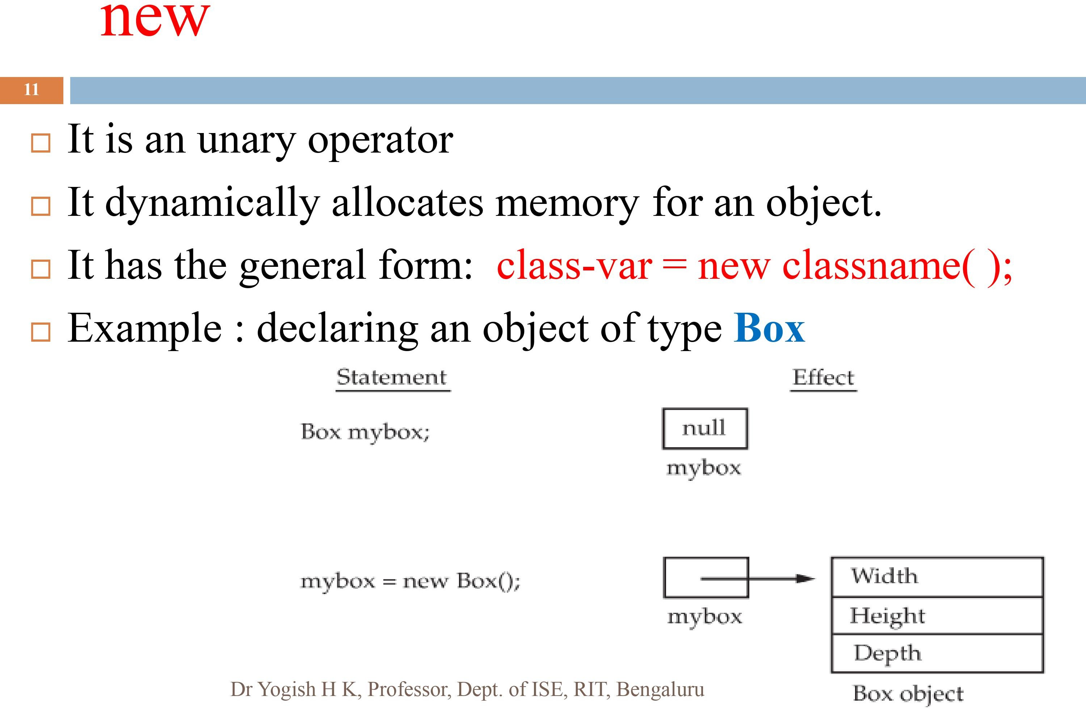

Slide 11
Assigning Object Reference Variables
Consider the following code fragment: Box b1= new Box();
Box b2 =bl·
'
b2 is being assigned a reference to a copy of the object
referred to by b1. Where b1 and b2 will both refer to the same object.
The assignment of b1 to b2 did not allocate any memory or copy any part of the original object.
It simply makes b2 refer to the same object as does b1.
Thus, any changes made to the object through b2 will affect the object to which b1 is referring, since they are the same
object.

Slide 12



Assigning Object Reference Variables ...
-
The above situation is depicted as shown below:
Width
Depth
bl
Box o’bject
b2

Slide 13
Methods
Methods are declared inside the body of the class but immediately after the declaration of instance variables.
The general form of a method declaration is: type methodname(parameter-list) {
// body of method
}

Slide 14
Methods
-
• • •
Here, type specifies the type of data returned by the method. This can be any valid type, including class
type.
If the method does not return a value, its return type must be void.
The name of the method is specified by methodname.
This can be any legal identifier.

Slide 15
Methods
-
• • •
The parameter-list is a sequence of type and identifier pairs separated by commas. If the method has no
parameters, then the parameter list will be empty.
Methods that have a return type other than void return a value to the calling routine using the following form of the return statement:
return value;
Here, value is the value returned.

Slide 16
Program to find Volume of Box - Without return value
class Box {
double width, height, depth;
void volume( ) {
System.out.print("Volume is "); System.out.println(width * height * depth);
}
}
class BoxDemo {
public static void main(String args[]) { Box myboxl = new Box(); myboxl.width = 10;
mybox1.height = 20; myboxl.depth = 15; myboxl.volume();
}
}

Slide 17
Program to find Volume of Box - With return value
-class Box {
double width, height, depth;
double volume() {
retum(width * height * depth);
}
}
class BoxDemo {
public static void main(String args[]) { Box myboxl = new Box(); myboxl.width= 10;
myboxl .height= 20;
myboxl.depth= 15;
double res=myboxl.volume();
System.out.println("Volume of box is"+ res);
}
}

Slide 18
Program to find Volume of Box - With return value and
method with arguments
class Box {
double width, height, depth;
double volume(double w, double h, double d)
{
width=w·
'
height=h; depth=d;
return(width *height* depth);
}
}

Slide 19
Program to find Volume of Box - With return value and
method with arguments
class BoxDemo {
public static void main(String args[]) { Box myboxl == new Box();
double res==myboxl .volume(l0,20,15);
System.out.println(''Volume of box is''+ res);
}
}

Slide 20
Constructors
A constructor is a special method or special member of the class which is used to initialize data members. whose name is the same as the name of its class in which it is declared and defined.
A constructor initializes an object immediately upon creation.
Once defined, the constructor is automatically called immediately after the object is created, before the new operator.
Constructors - have no return type, not even void because the implicit return type of a class constructor is the class type itself
The constructors are always public and non static.

Slide 21
Types of constructors
The default constructor or non parameterized constructor
Parameterized constructor
The copy constructor
The default constructor: The use of the class name as a function followed by empty parenthesis is known as default constructor or non parameterized constructor.
Parameterized constructor: The use of the class name as a function followed by one(or list of primitive date type)as parameters within the parenthesis is known as parameterized constructor.
The actual values to the arguments of the parameterized constructor are passed at the time of creation of the object of the class.
The copy constructor: This constructor is used to initialize one object along with the stored values to another object of the same class during declaration.

Slide 22
Default constructor to initialize the dimensions of a box
class Box {
double width, height, depth;
Box() {
System.out.println("Constructing Box");
width= 10; height =10; depth=10;
}
double volume() {
return width * height * depth;
}
class BoxDemo {
public static void main(String args[]) {
// declare, allocate, and initialize Box objects
Box myboxl = new Box();
System.out.println("Volume is " + myboxl .volume());
} }
'

Slide 23
Parameterized Constructors - Having parameters
class Box {
double width, height, depth;
Box(double w, double h, double d) { System.out.println("Constructing Box");
width= w;
height=h;
depth= d;
}
double volume() {
return width * height * depth;
}
}
'

Slide 24
Parameterized Constructors - Having parameters ...
class BoxDemo {
public static void main(String args[]) {
// declare, allocate, and initialize Box objects Box myboxl == new Box(l0,20,5);
System.out.println("Volume is " + myboxl .volume());
}
}

Slide 25
Why copy constructor is required?
Sometimes, we face a problem where we required to create an exact copy of an existing object of the class. There is also a condition, if we have made any changes in the copy it should not reflect in the original one and vice-versa. For such cases, Java provides the concept of a copy constructor.
public class Fruit
{
private double fprice;
private String fname;
//constructor to initialize price and name
Fruit(double fPrice, String fName)
{
fprice = fPrice;
fname = fName;
}

Slide 26
//creating a copy constructor
Fruit(Fruit fruit)
{
System.out.println("\nAfter invoking the Copy Constructor:\n");
fprice = fruit.fprice;
fname = fruit.fname;
}
//creating a method that returns the price of the fruit
double showPrice()
{
return fprice;
}
//creating a method that returns the name of the fruit
String showName()
{
return fname;
}

Slide 27
//class to create student object and print roll number and name of the student
public static void main(String args[])
{
Fruit f1 = new Fruit(399, "Ruby Roman Grapes");
System.out.println("Name of the first fruit: "+ f1.showName());
System.out.println("Price of the first fruit: "+ f1.showPrice());
//passing the parameters to the copy constructor
Fruit f2 = new Fruit(f1);
System.out.println("Name of the second fruit: "+ f2.showName());
System.out.println("Price of the second fruit: "+ f2.showPrice());
}
}

Slide 28
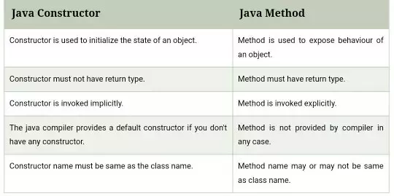
Differences between Constructor and Method

Slide 29
The this Keyword
this can be used inside any method to refer to the current object. That is, this is always a reference to the object on which the method was invoked.
Example
Box(double w, double h, double d) {
width = w; height = h ·; depth = d ;
}
it is similar to
Box(double w, double h, double d) { this.width=w; this.height=h; this.depth=d;
}
Inside Box( ), this will always refer to the invoking object.

Slide 30
this: to refer current class instance variable
The this keyword can be used to refer current class instance variable.
If there is ambiguity between the instance variables and formal parameters, this keyword resolves the problem of ambiguity.
This keyword can be used only in the non static context.

Slide 31
Let's understand the problem if we don't use this keyword by the example given below:
class Student{
int rollno;
String name;
float fee;
Student(int rollno,String name,float fee){
rollno=rollno;
name=name;
fee=fee;
}
void display(){
System.out.println(rollno+" "+name+" "+fee);}
}
class TestThis1{
public static void main(String args[]){
Student s1=new Student(111,"ankit",5000f);
Student s2=new Student(112,"sumit",6000f);
s1.display();
s2.display();
} }
Output:
0 null 0.0
0 null 0.0

Slide 32
In the above example, parameters (formal arguments) and instance variables are same. So, we are using this keyword to distinguish local variable and instance variable.
class Student{
int rollno;
String name;
float fee;
Student(int rollno,String name,float fee){
this.rollno=rollno;
this.name=name;
this.fee=fee;
}
void display(){
System.out.println(rollno+" "+name+" "+fee);}
}
class TestThis2{
public static void main(String args[]){
Student s1=new Student(111,"ankit",5000f);
Student s2=new Student(112,"sumit",6000f);
s1.display();
s2.display();
}}
OUTPUT:
111 ankit 5000.0
112 sumit 6000.0

Slide 33
If local variables(formal arguments) and instance variables are different, there is no need to use this keyword like in the following program:
class Student{
int rollno;
String name;
float fee;
Student(int r,String n,float f){
rollno=r;
name=n;
fee=f;
}
void display(){
System.out.println(rollno+" "+name+" "+fee);}
}
class TestThis3{
public static void main(String args[]){
Student s1=new Student(111,"ankit",5000f);
Student s2=new Student(112,"sumit",6000f);
s1.display();
s2.display();
}}
OUTPUT:
111 ankit 5000.0
112 sumit 6000.0

Slide 34
Instance Variable Hiding
It is illegal in Java to declare two local variables with the same name inside the same or enclosing scopes.
But you can have local variables, including formal parameters to methods, which overlap with the names of the class instance variables.
However, when a local variable has the same name as an instance variable, the local variable hides the instance variable.
This is why width, height, and depth were not used as the names of the parameters to the Box( ) constructor inside the Box class.
If they had been, then width would have referred to the formal parameter, hiding the instance variable width.
While it is usually easier to simply use different names or can use this to resolve any name space collisions that might occur between instance variables and local variables.

Slide 35
Instance Variable Hiding ...
Example, here is another version of Box( ), which uses width, height, and depth for parameter names and then uses this to access the instance variables by the same name:
Use this to resolve name-space collisions. Box(double width, double height, double depth) {
this.width= width;
this.height==height; this.depth= depth;
}

Slide 36
Garbage Collection
-
Since objects are dynamically allocated by using the new operator. In some languages, such as C++, dynamically allocated objects must be manually released by use of a delete operator.
Java handles deallocation automatically without the user intervention . The technique that accomplishes this is called garbage collection.
When no references to an object exist, that object is assumed to be no longer needed, and the memory occupied by the object can be reclaimed.
There is no need to explicitly destroy objects.
Garbage collection only occurs during the execution of program.
It will not occur simply because one or more objects exist that are no longer used.

Slide 37
Garbage Collection
It is a way to destroy the unused objects.
Advantage of Garbage Collection:
It makes java memory efficient because garbage collector removes the unreferenced objects from heap memory.
It is automatically done by the garbage collector(a part of JVM) so we don't need to make extra efforts.
Object can be unreferenced by using
i)By nulling a reference:
Employee e=new Employee();
e=null;
ii) By assigning a reference to another:
Employee e1=new Employee();
Employee e2=new Employee();
e1=e2;//now the first object referred by e1 is available for garbage collection iii) By anonymous object:
new Employee();

Slide 38
The finalize( ) Method
It is possible to define a method that will be called just before an object's final destruction by the garbage collector. This method is called finalize( ), and it can be used to ensure that an object terminates cleanly.
For example, you might use finalize() to make sure that an open file owned by that object is closed. To add a finalizer to a class, you simply define the finalize( ) method.
The Java runtime calls that method whenever it is about to reclaimed an object of that class. Inside the finalize( ) method, you will specify those actions that must be performed before an object is destroyed.

Slide 39
The finalize( ) Method ...
The finalize( ) method has this general form:
protected void finalize( )
{
// finalization code here
}
the keyword protected is a specifier that prevents access to finalize( ) by code defined outside its class.
finalize( ) method is a method of a class which is called just before the destruction of an object by the garbage collector.
finalize() method called only once by garbage collector.
After finalize( ) method gets executed completely, the object automatically gets destroyed.
The purpose of calling finalize method is to perform activities related to clean up, resource deallocation etc.

Slide 40
The finalize( ) Method
The finalize() method is invoked each time before the object is garbage collected. This method can be used to perform cleanup processing.
This method is defined in Object class as: protected void finalize()
{
}
gc() method:
The gc() method is used to invoke the garbage collector to perform cleanup processing.
The gc() is found in System and Runtime classes.

Slide 41
The finalize( ) Method
class TestGarbage{
public void finalize()
{
System.out.println("object is garbage collected");
}
public static void main(String args[]){
TestGarbage s1=new TestGarbage();
TestGarbage s2=new TestGarbage();
s1=null;
s2=null;
System.gc();
}
}

Slide 42
Student Class
class Student{
int id;
String name;
}
class Teststudent {
public static void main(String args[]){ Student s = new Student(); System.out.println(s.id + s.name);
}
}

Slide 43
initialize object - reference
class Student{
int id;
String name;
}
class Teststudent{
public static void main(String args[]){ Student s = new Student();
s.id=120;
s.name='' Viraat'';
System.out.println(s.id + s.name);
}
}

Slide 44
initialize object - method
class Student{
int id;
String name;
void getd(int num, String s ) {
id=num·
'
name=s;
}
void disp() {
System.out.println(id +name);
}
}
class Teststudent{
public static void main(String args[]){ Student s =new Student(); s.getd(l20,"Viraat");
s.disp();
}
}

Slide 45
initialize object - constructor
class Student{
int id;
String name;
Student(int num, String s ) {
id=num·
'
name=s;
}
void disp() { System.out.println(id +name);
}
}
class Teststudent{
public static void main(String args[]){ Student s=new Student(120,"Viraat"); s.disp();
}
}

Slide 46
Overloading Methods
Two or more methods within the same class that share the same name, but
differ by parameter.
overloaded methods must differ in the type and/or number of their parameters.
Method overloading is one of the ways that Java supports polymorphism.
When an overloaded method is invoked, Java uses the type and/or number of arguments as its guide to determine which version of the overloaded method to actually call.
When Java encounters a call to an overloaded method, it simply executes the version of the method whose parameters match the arguments used in the call.

Slide 47
Overloading Methods ... Example
class OverloadDemo {
void test() {
System.out.println("No parameters");
}
void test(int a) { // Overload test for one integer parameter System.out.println("a: " + a);
}
void test(int a, int b) { // Overload test for two integer parameters System.out.println("a and b: " +a+ " " + b);
}
void test(double a) { // overload test for a double parameter System.out.println("double a: " + a);
}
.
}

Slide 48
Overloading Methods ... Example
class Overload {
public static void main(String args[]) {
OverloadDemo ob == new OverloadDemo();
ob.test();
ob.test(l0, 20);
ob.test(123.25);
ob.test(l0);
} }
Here test() is overloaded four times. When overloaded method is called, java looks for a match between the arguments used to call the method and method’s parameter.
Java’s automatic type conversions play a role in overload.
int i=88; and test(double a) then ob.test(i);will invoke test(double) if test(int a) is not existing.

Slide 49
Overloading Constructors
Like
a normal methods, we can also overload
constructor methods.
Example:
class Box {
double width, height, depth; Box() {
width== -1·
// use -1 to indicate
II an uninitialized
//box
'
height == -1;
depth== -1;
}

Slide 50
Continue ...
// constructor used when cube is created Box(double len) {
width ==height = depth = len;
}
// constructor used when all dimensions specified Box(double w, double h, double d) {
width= w·
'
height= h; depth= d;
}
double volume() {
return width * height * depth;
}
}

Slide 51
Continue ...
class OverloadCons {
public static void main(String args[]) { II create boxes using the various constructors Box myboxl = new Box(l0, 20, 15);
Box mybox2 = new Box(); Box mybox3 = new Box(7);
double vol;
vol =myboxl.volume(); II get volume of first box System.out.println(¹¹Volume of myboxl is ¹¹ + vol);
vol= mybox2.volume(); II get volume of second box System.out.println(¹¹Volume of mybox2 is ¹¹ + vol);
vol= mybox3.volume(); II get volume of cube System.out.println(¹¹Volume of mycube is ¹¹ + vol);
}
}
.

Slide 52
Using Objects as Parameters
So far, we have only been using simple types as parameters to methods. However, it is both correct to pass objects to methods.
class Test {
int a, b;
Test(int i, int j) {
a=i;
b = j;
}
II return true if obj is equal to the invoking object boolean equals(Test obj) {
if(a == obj.a && b == obj.b)
return true;
else
return false;
}
}

Slide 53
Using Objects as Parameters
• • •
class PassOb {
public static void main(String args[]) { Test obl=new Test(l00, 22);
Test ob2=new Test(l00, 22);
Test ob3 =new Test(-1, -1);
System.out.println("obl === ob2: "+ obl.equalTo(ob2)); System.out.println("ob1 === ob3: " + ob1 .equalTo(ob3));
}
}

Slide 54
Argument Passing: Two ways to pass an argument to a function or method.
-
call-by-value. This approach copies the value of an argument into the formal parameter of the method. Therefore, changes made to the parameter of the method have no effect on the argument.
Calling or invoking the method by passing primitive type of data is called call by value/pass by value. Thus, what occurs to the parameter that receives the argument has no effect outside the method.

Slide 55
Call by value ... example
class Test
{
void fun(int i, int j)
{
i*=2;
j/=2;
}
}
class CallByValue
{
public static void main(String args[])
{
Test ob=new Test();
int a= 15, b = 20;
System.out.println("a and b before call: " +a+ " " + b);
ob.fun(a, b);
System.out.println("a and b after call: " + a+ " " + b);
}
}

Slide 56
Call by value ... example ...
-
The output from this program is shown here:
a and b before call: 15 20 a and b after call: 15 20

Slide 57
Call by Reference
-
call-by-reference. In this approach, a reference to an argument (not the value of the argument) is passed to the parameter. Inside the method, this reference is used to access the actual argument specified in the call. This means that changes made to the parameter will affect the argument used to call the method.
Calling or invoking the method by passing reference variables is called pass by reference/call by reference.

Slide 58
Call by reference ... example ...
-
Pass an object to a method
When you create a variable of a class type, you are only creating a reference to an object. Thus, when you pass this reference to a method, the parameter that receives it will refer to the same object as that referred to by the
argument. This effectively means that objects are passed to methods by use of call-by-reference.
Changes to the object inside the method do affect the object used as an argument.

Slide 59
Call by reference ... example ...
-­
class Test {
int a, b;
Test(int i, int j) {
a= i ;
b = j;
}
// pass an object void fun(Test obj) {
obj.a * = 2;
obj.b /= 2;
}
}

Slide 60
Call by reference ... example ...
-
class CallByRef {
public static void main(String args[]) { Test ob = new Test(15, 20);
System.out.println("ob.a and ob.b before call: " + ob.a+ " " + ob.b);
ob.fun(ob);
System.out.println("ob.a and ob.b after call: " + ob.a+ " " + ob.b);
}
}
This program generates the fallowing output: ob.a and ob.b before call: 15 20
ob.a and ob.b after call: 30 10

Slide 61
Introducing Access Control
Encapsulation provides another important attribute: access control.
Through encapsulation, you can control what parts of a program can access the members of a class. By controlling access, you can prevent misuse.
Access specifiers is used to restrict the access from one class to another class or from one package to another package.
Java's access specifiers are default/package level, public, private, and protected.

Slide 62
Introducing Access Control
Protected applies only when inheritance is involved.
When a member of a class is modified by the public specifier, then that member can be accessed by any other code.
When a member of a class is specified as private, then that member can only be accessed by other members of its class.
When no access specifier is used, then by default the member of a class is public within its own package, but cannot be accessed outside its package.

Slide 63
main() has always been preceded by the public specifier. It is called by code that is outside the program-that is, by the Java run-time system.
public can be accessed
within the class.
within the package
outside the package
Application level

Slide 64
Protected can be accessed:
within the class.
within the package
outside the package with IS a relationship
Private can be accessed only within the class.
Default access specifier /package level:
If any member of the class declared without any access specifier is called as Default access specifier .
A class members can have all four access specifiers
The class can have only two access specifier i.e public and default.

Slide 65
class Demo //public or default
{
variables; // these are can be any one out of four
Methods;
Constructors;
}

Slide 66
There are four types of Java access modifiers:
Private: The access level of a private modifier is only within the class. It cannot be accessed from outside the class.
Default: The access level of a default modifier is only within the package. It cannot be accessed from outside the package. If you do not specify any access level, it will be the default.
Protected: The access level of a protected modifier is within the package and outside the package through child class. If you do not make the child class, it cannot be accessed from outside the package.
Public: The access level of a public modifier is everywhere. It can be accessed from within the class, outside the class, within the package and outside the package.

Slide 67
Protected modifier
class A{
protected void msg()
{
System.out.println("Hello");}
}
class B extends A{
public static void main(String args[]){
B obj = new B();
obj.msg();
}
}
class Animal {
protected void display()
{
System.out.println("I am an animal");
}
}
class Dog extends Animal {
public static void main(String[] args) {
// create an object of Dog class
Dog dog = new Dog();
// access protected method
dog.display();
}
}

Slide 68
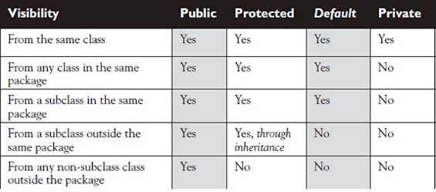
Access Specifiers

Slide 69
Introducing Access Control
• • •
class Test {
int a;
public int b; private int c;
II default access II public access II private access
II methods to access c
II set c's value
C == i;
void setc(int i) {
}
int getc() {
II get c's value
return c;
}
}

Slide 70
Introducing Access Control
--
• • •
class AccessTest {
public static void main(String args[]) { Test ob = new Test();
ob.a=10;
ob.b =20;
II These are OK, a and b may be accessed directly
II This is not OK and will cause an error
II ob.c == 100; II Error! You must access c through its methods because its declared private
ob.setc(l00); II OK
System.out.println("a, b, and c: " +ob.a+ " " + ob.b + " " + ob.getc());
}
}

Slide 71
Static Variables and Methods
Static Variables : The static keyword is used to create variables that will exist independently of any instances created for the class.
Any member of the class declared with a keyword static is called as static member of the class.
Static is always associated with class.
Static members will be stored in static pool area.
Static variables are also known as class variables.
A static method can access only static members.
They cannot refer to this or super

Slide 72
Static Variables and Methods
Only one copy of the static variable exists regardless of the number of instances of the class.
Java provides a separate block called SIB(static Initialization Block).
Static Initialization Block:
Any block which is declared with a keyword static is called as static initialization block.
SIB is used to initialize static members.
Before main method SIB will get executed.
we can have N number of SIB, the order of execution is sequential.

Slide 73
Example: shows a class that has a static method, some static
variables, and a static initialization block:
-class UseStatic {
static int a = 3; static int b;
static void fun(int x) {
System.out.println("x = " + x); System.out.println("a = " + a); System.out.println("b = " + b);
}
static {
System.out.println("Static block1 initialized.");
b=a*4;
}
public static void main(String args[]) {
fun(42);
}//end of main }//end of class
b =a* 4·
'
Output: Static Block1 is initialized
X=42 a=3 b=12

Slide 74
Continue ...
As soon as the UseStatic class is loaded, all of the static statements are
run.
First, a is set to 3,
then the static block executes, which prints a message and then initializes b to a*4 or 12.
Then main( ) is called, which calls fun( ), passing 42 to x.
The three println( ) statements refer to the two static variables a and b, as well as to the local variable x.

Slide 75
Continue ...
Outside of the class in which they are defined, static methods and variables can be used independently of any object. To do so, you need only specify the name of their class followed by the dot operator.
For example, if you wish to call a static method from outside its class, you can do so using the fallowing general form:
classname.method( ) ;
Here, classname is the name of the class in which the static method is declared.

Slide 76
Continue ... Example
--
class StaticDemo {
static int a = 42; static int b = 99; static void callme() {
System.out.println("a == " + a);
}
}
class StaticByName {
public static void main(String args[])
{
StaticDemo.callme();
System.out.println("b = " + StaticDemo.b );
}
}

Slide 77
Introducing final
A variable can be declared as final.
Doing so prevents its contents from being modified.
You must initialize a final variable when it is declared.
For example:
final int SIZE= 1O;
final double PI= 3.14;
final int QUIT= 5;
Subsequent parts of your program can now use SIZE, PI etc.,

Slide 78
Students details
class Student{
int rollno; String name;
Student(int r, String n){
rollno==r·
name==n·
'
'
}
void display(){
System.out.println(rollno+" "+name);
}
}

Slide 79
class Main{
public static void main(String[] args) {
Student s[]==new Student [2]; s[O]==new Student(120, "Karan"); s[l ]==new Student(222, "Arjun"); s[O].display();
s[1].display();
}
}

Slide 80
Java User Input - from key board
--
The Scanner class is used to get user input, and it is found in the java.util package.
import java.util.Scanner;
class Main {
public static void main(String[] args) {
Scanner in= new Scanner(System.in);
System.out.println("Enter Number"); int num= in.nextlnt();
II Import the Scanner class
II Create a Scanner object
II Read user input
System.out.println("User num is: " + num); II Output user input
}
}

Slide 81
Java User Input - from key board
Input Types
Method | Description
nextBoolean() | Reads a boolean
nextByte() | Reads a byte
nextShort() | Reads a short
nextInt() | Reads a int
nextFloat() | Reads a float
nextDouble() | Reads a double
nextLong() | Reads a long
nextLine() | Reads a String
Next().charAt(0) | Reads a Character

